Slide 1
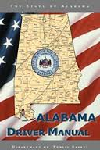
Alabama Driver Manual
Chapter Two

Slide 2
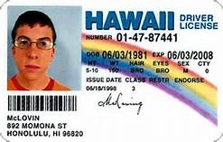
You May Lose Your License
Cancellation and Revocation

Slide 3
Reinstatement Fees
Any license disqualification will require at minimum a $100 reinstatement fee.
The Fee will increase depending upon the reason for revocation, cancellation, or suspension.
Example: Alcohol or Drug related offenses will be $275.

Slide 4
Cancellation
Cancellation is the PERMANENT annulment or termination of an individual’s license by formal action by a government entity.
Unlike REVOCATION or SUSPENSION, once a license is CANCELLED, it CANNOT be reacquired.

Slide 5
Reasons for Cancellation:
Failing to give correct information on a driver license application.
Committing any fraud in making an application for a driver license.
Example: Providing a false name/social security number on a driver license application

Slide 6
National Driver Registry
To prevent fraud, the National Driver Registry (NDR) routinely cross-references new applicants’ information with information on previously issued licenses.

Slide 7
Revocation
Revocation is the temporary annulment of a driver license by a government entity.
Drivers with revoked licenses must apply for a new license when their period of revocation expires, and must also pass the complete driver examination in order to regain driving privileges.

Slide 8
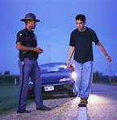
Reasons for Revocation
Vehicular manslaughter or homicide
Second DUI conviction (Alcohol)
Second DUI conviction (Controlled Substance)

Slide 9
Reasons for Revocation Continued
Operating a motor vehicle in the commission of a felony
Unauthorized use of a motor vehicle belonging to another (stealing a car)

Slide 10
Reasons for Revocation Continued
Failure to stop, render aid, or identify yourself in the event of an accident resulting in the personal injury or death of another.
Perjury, or making false statements under oath to Director regarding ownership and/or operation of motor vehicles
Three reckless driving charges within 12 months.

Slide 11
SUSPENSION

Slide 12
SUSPENSION
A driver license may be suspended if a driver is convicted of certain offenses or is judged incompetent to operate a motor vehicle. After the period of suspension, the driver license will be reinstated unless it expired during the period of the suspension, or unless all the requirements of the suspension were not met.

Slide 13
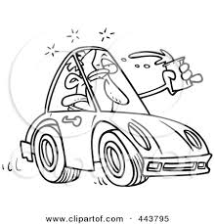
First offense DUI or drugs (juvenile and adult).
Refusing a breathalyzer test to determine blood alcohol content

Slide 14
Are convicted of fleeing or attempting to elude a police officer.
Are convicted of racing on the highways.

Slide 15
Have 4 or more points accrued on driving record or 2 or more moving traffic violations on Graduated Driver License (GDL).
Have committed an offense in another state which, if committed in this state, would be grounds for suspension or revocation.

Slide 16
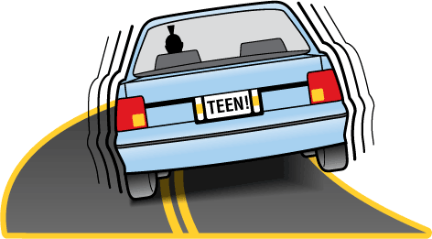
Have been convicted with such frequency of serious offenses against traffic regulations governing the movement of vehicles to indicate disrespect for traffic laws, and a disregard for the safety of other persons on the highways.

Slide 17
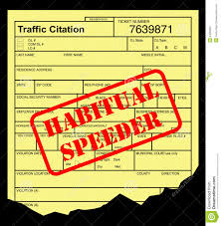
Are a habitually reckless or negligent driver of a motor vehicle as established by a record of accidents or other evidence.

Slide 18
Are incompetent to drive a motor vehicle.
Have medical reasons.

Slide 19
Have permitted an unlawful or fraudulent use of your license or mutilated such license.
Are ages 15-18 and withdraw from school under certain conditions prior to graduation.

Slide 20
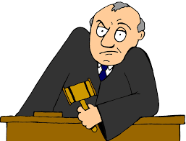
Fail to maintain SR-22 insurance when required.
Have non-payment of child support.
Fail to answer a traffic court summons on time or fail to pay.

Slide 21
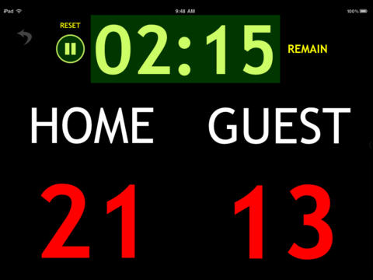
The Alabama Drivers Point System

Slide 22
Alabama Point System as explained by Alabama Driver License Suspension Attorney - Joseph C. Kreps Traffic Ticket Attorney in Alabama. (2013, July 12). Alabama Driver License Suspension Attorney - Joseph C. Kreps - Alabama Driver License Point System [Video File]. Retrieved from https://www.youtube.com/watch?v=QtIIppfVqZM

Slide 23
The Alabama Point System
What is it, and how does it work?
It is a uniform system for suspending drivers licenses based on driving records over a two year period.
It works by keeping a running total of points a driver accumulates over the previous two years.
Once a driver reaches a certain point total their license will be suspended.
Suspension length depends upon the amount of points that have been accumulated.

Slide 24
Major Violations and Point Values.
Conviction that resulted from a charge that involved the drinking of alcoholic beverages and the driving of a motor vehicle but did not require mandatory revocation of the driver license. - 6 Pts.
Reckless Driving or Reckless Endangerment involving operating a motor vehicle – 6 Pts.
Admin Per Se (Refusal of BAC test or Failure of BAC) - 6 Pts.
Failure to yield right of way – 5 Pts.
Passing a stopped school bus – 5 Pts.
Speeding 26 MPH or more over the speed limit – 5 Pts.

Slide 25
Violations Worth 3 to 4 Points (Moderate)
Driving on the wrong side of the road – 4 Pts.
Illegal Passing – 4 Pts.
Following to closely – 3 Pts.
Disregarding a traffic control device (stop sign or traffic light) – 3 Pts.
Failure to Obey Construction/Maintenance Zone Markers/Flagmen/Police Officer/Restricted Lane – 3 Pts.

Slide 26
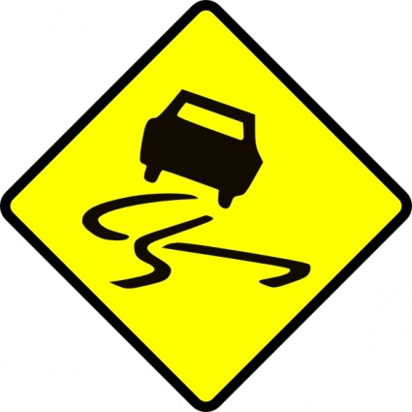
Minor Violations all worth 2 Pts.
Inability to Control a Vehicle
Improper Lane Violation
Speeding Violation to Include 1 – 25 mph. Over Speed Limit
Drinking Alcohol While Operating a Vehicle
Improper Operation of a Motorcycle

Slide 27
Minor Violations all worth 2 Pts. (Cont.)
Emergency Vehicle Violation
Failure to Signal/Use Incorrect Turn Signal
Making an Improper Turn
Coasting
Unsafe Operation

Slide 28
Point Accumulation Suspension Period
12 – 14 Points in a 2-year period 60 days
15– 17 Points in a 2-year period 90 days
18– 20 Points in a 2-year period 120 days
21 – 23 Points in a 2-year period 180 days
24 and above points in a 2-year period 365 days

Slide 29
SUSPENDED

Slide 30
Upon receipt of notice of suspension
The driver may request a pre-suspension or administrative hearing in the county of his/her residence before an agent of the Director of Public Safety.
The purpose of the hearing is to permit the Licensee to present any legal or lawful reason why the suspension should not be imposed, or to determine if the Licensee is a candidate for a probationary status.
Request must be made within 10 calendar days of the “notice mail date”.

Slide 31
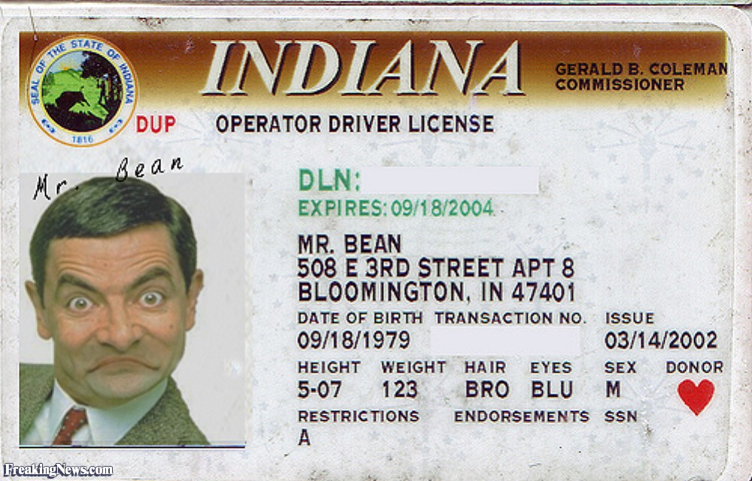
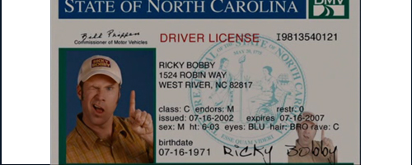
Where to send hearing requests
Driver License Division
P.O. Box 1471
Montgomery, AL 36102-1471

Slide 32
Remember
Reports of traffic convictions shall retain their point value for suspension purposes for a period of two years from the date of conviction but remain on a drivers record forever.

