Slide 1
The Courts
AP U.S. Government Chapter 14

Slide 2
Sources of Amer. Law
Constitutions-> state and federal
Statutes and Administrative Regulations
Statutes-> laws made by legislatures
Admins. Regulations -> issued by admins. agencies… courts may be called on to interpret
Case Law -> Stare decisis, U.S. case law is based on precedent

Slide 3
Powers of the Federal Courts
1. Jurisdiction of Courts
2. Supreme Court Power
3. Due Process and Regulatory Power

Slide 4
Jurisdiction of Courts
Dual Court System
State Court jurisdiction -> state laws
Federal Court jurisdiction ->U.S. law, foreign treaties, interpret constitution
Concurrent jurisdiction -> state and federal
Federal trial courts -> district courts that have original jurisdiction
Federal Court of Appeals ->apellate jurisdiction -> hear cases appealed from district courts

Slide 5
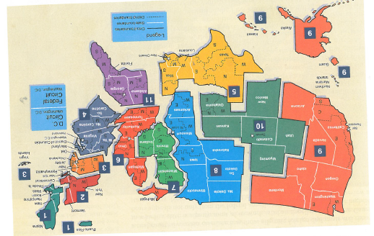

Slide 6
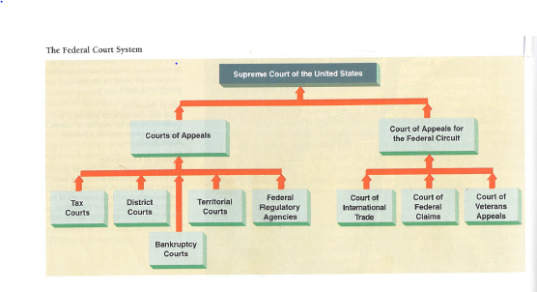

Slide 7
Supreme Court Power
Power developed from custom, usage and history
No federal court may initiate action
Jurisdiction:
Federal question (Interpret Constitution, U.S, law, treaties)
Diversity of citizenship
“Standing to sue”
Types- 3 tiered
U.S. District Courts-> civil and criminal trials
U.S. Court of Appeals-> 13 courts=12 districts and 1 national appellate (Fed. Claims)-> uphold, reverse or send back
Supreme Court (Handout)

Slide 8
Supreme Court (handout)
Supreme Court
9 Supreme Court Justices (8 Associates and 1 Chief)
Appointed by President and approved by Senate
Main duties: hear and rule on cases
Chief provides leadership and presides over sessions
How cases reach the court:
Majority of cases referred on appeals from lower courts (Most concern laws ruled unconstitutional)
Some dismissed
Writ of Certiorari- error or raises serious constitutional issue
Chief Justice puts Writ of Certiorari cases on a list for discussions—4 justices agree, case is accepted
Some are decided by a brief
2/3 never make it

Slide 9
Steps in deciding major cases:
Each submits a brief
Lawyers for each side make arguments
On Wed. and Fri. the Chief Justice presides over a secret conference in which the case is summarized and recommendations are made on how to handle
Justices debate case, each Justice has 1 vote, majority decides
4 opinions: 1. unanimous 2. majority 3. concurring 4. dissenting
C.J. assigns justices to write opinions

Slide 10
Shaping public policy: (Judicial activism and restraint) (Strict and Broad Construction)
using judicial review- power to declare unconstitutional federal or state laws and other acts of gov’t.
interpreting laws
over-ruling or reversing previous decisions

Slide 11
Limits:
Limits on types of issues
Limits on types of cases (decision will make a difference, real harm, federal question)
limited control of agenda (appeals)
Lack of enforcement (noncompliance difficult to monitor)
Checks and Balance (President and Congress)
Public Opinion

Slide 12
Woll reading p. 448-57 by Justice William J. Brennan, Jr.
How the Supreme Court Arrives as Decisions
Answers Unclear
Society is Disturbed
Petition and Response
Order of Seating
Each Side Get Hour
Opinions Assigned
Some Change Minds
Uniform Rule
Freund’s View
Consensus Needed
Painful Accusation

